Slide 1

BFX-AT100 Control Run New FATP Result Report
Prepare by: PE. Thuc
Date : 2023.03.02

Slide 2
#1
Control Run Contents
Software
Process
ECN
Material
Other
V
1. Background Information:
Change production line from line 10 at F16-1F site to line K3 at F07-3F site.
Quantity: 100pcs.
2. Purpose control run:
Verify new test environment at F07-3F site.
Check operation of test equipment after moving.
3. Control run process:
SMT
PTH
A
Kitting
UK
Assy
FT
A
RC1
OBA
FT1
RC
PACKING
FG
Burning
RC2
4. Summary: Control run only verify new production line and don’t change HW, SW , test program follow test plan.

Slide 3
#2
Control Run Procedure And Result
Step | Items | CTQ | Contents | Q’ty (pcs) | Result
1 | Kiting ➔SMT ➔PTH | None | Normal process | 100 | Pass
2 | UK station | Yes | Normal process | 100 | Pass
3 | Assy | None | Assembly housing | 100 | Pass
4 | FT station | Yes | Test HDMI function | 100 | Pass
5 | FT1 | Yes | Test TX,RX throughput, LED , Audio, Bluetooth functions (CPK TX&RX throughput, Bluetooth RSSI value >1.33) | 100 | Pass
6 | RC | Yes | Upgrade customer software | 100 | Pass
7 | Burning | Yes | Burning after upgrading customer SW | 100 | Pass
8 | RC1 | Yes | Check scan QR code | 100 | Pass
9 | OBA | Yes | Check all function of product at customer software | 100 | Pass
10 | RC2 | Yes | Check scan QR code | 100 | Pass
11 | Packing→ FG | None | Normal process | 100 | Pass
Summary:
- CTQ stations: all station on FATP.

Slide 4
#3
Final Test Yield Rate
ALT |  |  | Model Name | BFX-AT100
 |  |  | Quantity | 100pcs
 |  |  | Production image | k000b-523r06_SD_fac-20220118
 |  |  | Customer image | 15.534.28
 |  |  | MO | 2643002664
 |  |  | Date | 03/01/2023
1.Product Yield & FA Report
Customer | Product Model | Test Station |  | Yield Rate | Statistical | Yield Rate
ALT | BFX-AT100 | UK |  | 100.00% | Total | 100
 |  |  |  |  | Pass | 100
 |  |  |  |  | Fail | 0
 |  |  |  |  | Yield Rate(%) | 100.00%
 |  | FT |  | 100.00% | Total | 100
 |  |  |  |  | Pass | 100
 |  |  |  |  | Fail | 0
 |  |  |  |  | Yield Rate(%) | 100.00%
 |  | FT1 |  | 100.00% | Total | 100
 |  |  |  |  | Pass | 100
 |  |  |  |  | Fail | 0
 |  |  |  |  | Yield Rate(%) | 100.00%
 |  | RC |  | 100.00% | Total | 100
 |  |  |  |  | Pass | 100
 |  |  |  |  | Fail | 0
 |  |  |  |  | Yield Rate(%) | 100.00%
 |  | RC1 |  | 100.00% | Total | 100
 |  |  |  |  | Pass | 100
 |  |  |  |  | Fail | 0
 |  |  |  |  | Yield Rate(%) | 100.00%
 |  | RC2 |  | 100.00% | Total | 100
 |  |  |  |  | Pass | 100
 |  |  |  |  | Fail | 0
 |  |  |  |  | Yield Rate(%) | 100.00%
 |  | Final Yield Rate(%) |  | 100.00%
Summary: Final yield rate is 100%.

Slide 5
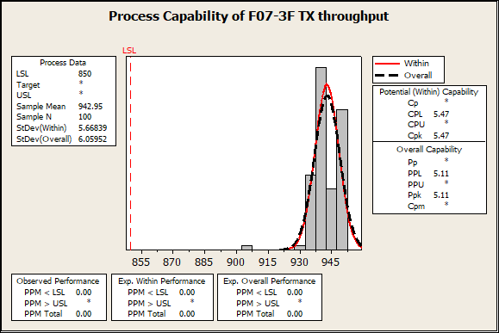
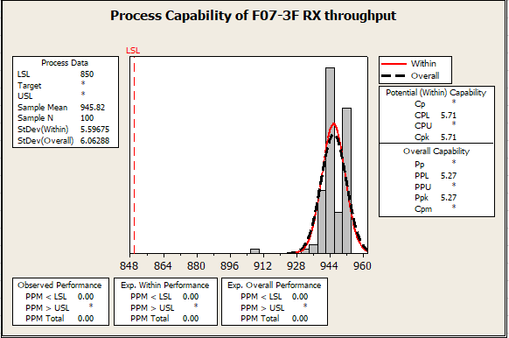
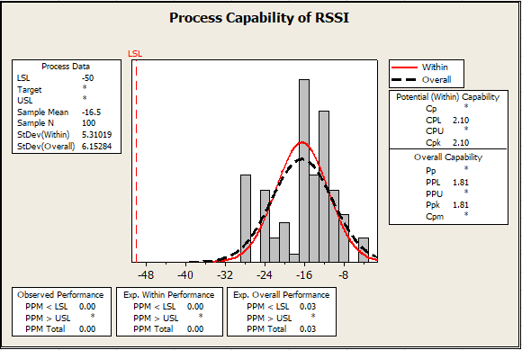
#4
CPK Verification
CPK TX, RX throughput, Bluetooth RSSI data checking:
No.# | Items | CPK value | CPK picture | Remark
1 | TX throughput | 5.47 |  | All CPK value can meet target >1.33
2 | RX throughput | 5.71
3 | Bluetooth RSSI | 2.10

Slide 6
#5
Control Run Result Summary
Control Run Result Summary:
1. FATP test yield rate was 100% ➔ No found any failure relate to new test environment
2. OBA testing result ➔ No abnormal issue found.
3. CPK data checking ➔ Can meet target >1.33
Control Run Conclusion:
FII didn’t find out any abnormality related to new test environment at F07-3F site.
➔ We can apply new production line at F07-3F site for MP.

